Slide 1

TASK-6
Reading data from Bank of Baroda CSV file and plotting Candlestick pattern in Python
SATISH NAGAR
DATA SCIENCE INTERN
AT HACKVEDA LTD.

Slide 2
Table of contents
01
02
Hook story
Introduction
03
04
Candlestick
Flow of Project

Slide 3
Table of contents
05
06
Future Scope
Conclusion
07
08
Reference
Contact

Slide 4
HOOK - STORY
Highlight the significance of stock market analysis.
Praveen, a investor.
The need for predictive modeling in stock trading.
Take raw stock market data, analyze it, and turn it into useful insights

Slide 5
Introduction
Overview of stock market complexities.
Importance of visualizing trends and patterns.
Brief on using candlestick plots as a tool for analysis.

Slide 6
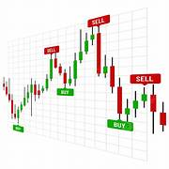
Candlestick
Explanation of candlestick Matric (open, high, low, closing price).
Importance of candlestick charts in trend analysis.
Benefits of visualizing stock data through candlesticks.

Slide 7



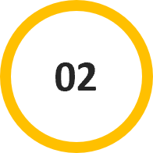
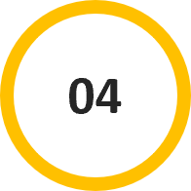
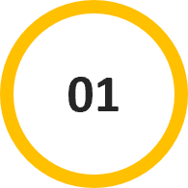
Flow of Project
Importing data
FOR MORE –Click HERE
DATA Preprocessing
FOR MORE –Click HERE
STEPS
Libraries
FOR MORE –Click HERE
Candlestick
Plot
FOR MORE –Click HERE

Slide 8
Step 1 – Importing Data
Downloading the CSV file.
Loading it into a pandas DataFrame.
Checking the integrity of the imported data (e.g., verifying null values, data types).

Slide 9
Step 2 : Data Preprocessing
Data preprocessing is essential to ensure the data's format and structure are ready for analysis.
Includes steps such as:
Converting the 'Date' column to datetime format.
Setting the 'Date' column as the DataFrame's index.

Slide 10
Step 3 : Importing Libraries
Install the pandas and plotly libraries to meet the necessary dependencies for smooth execution.
Use the commands pip install pandas and pip install plotly for installing the libraries.
Import the libraries in a Python script to complete the setup process.

Slide 11
Step4 : Creating Candlestick Plot
The main objective of the project is to create a Candlestick plot to visually represent Bank of Baroda's stock data.
Using plotly.graph_objects, I have built the Candlestick plot.
I customized the visual attributes to improve clarity and interpretability.

Slide 12
Future Scope
Extend the model to predict future stock prices.
Integrate AI/ML models for more accurate predictions.
Build a user-friendly dashboard for real-time data visualization.

Slide 13
Conclusion
The importance of stock market visualization.
The achievements of the project.
The benefits for investors and analysts.

Slide 14
Reference
Data set : https://trello.com/1/cards/6438c561324b51d6acb221e1/attachments/643ff55dd651987ffe1ad119/download/StockDataBANKBARODA_1.csv
Youtube: https://www.youtube.com/watch?v=dQ9Qc3f0RpM&t=18s
ChatGpt

Slide 15



Contact
For any queries,
feel free to reach out at
satishnagar248@gmail.com
www.linkedin.com/in/satish-nagar-nilu

Slide 16
Thank-you☺

